Slide 1
Unguided project:
Made by-
Anshu pandey(18csu026)
Abhishek(18csu007)
Abhishek(18csu010)
amit
ankit

Slide 2
What to do:
To make the meun driven program.
Use switch case
1.)create database
ask the user to enter the name of the database
& ask the folder path to be created.
2.)delete database
ask the user for database name to be deleted.
3.)create Table
ask the user for system details from the user & columns and create a csv file with the columns name .and file name as tablename.
we will use arraylist
4.)delete table
ask from the user about the table name and system will deletes the csv file .

Slide 3
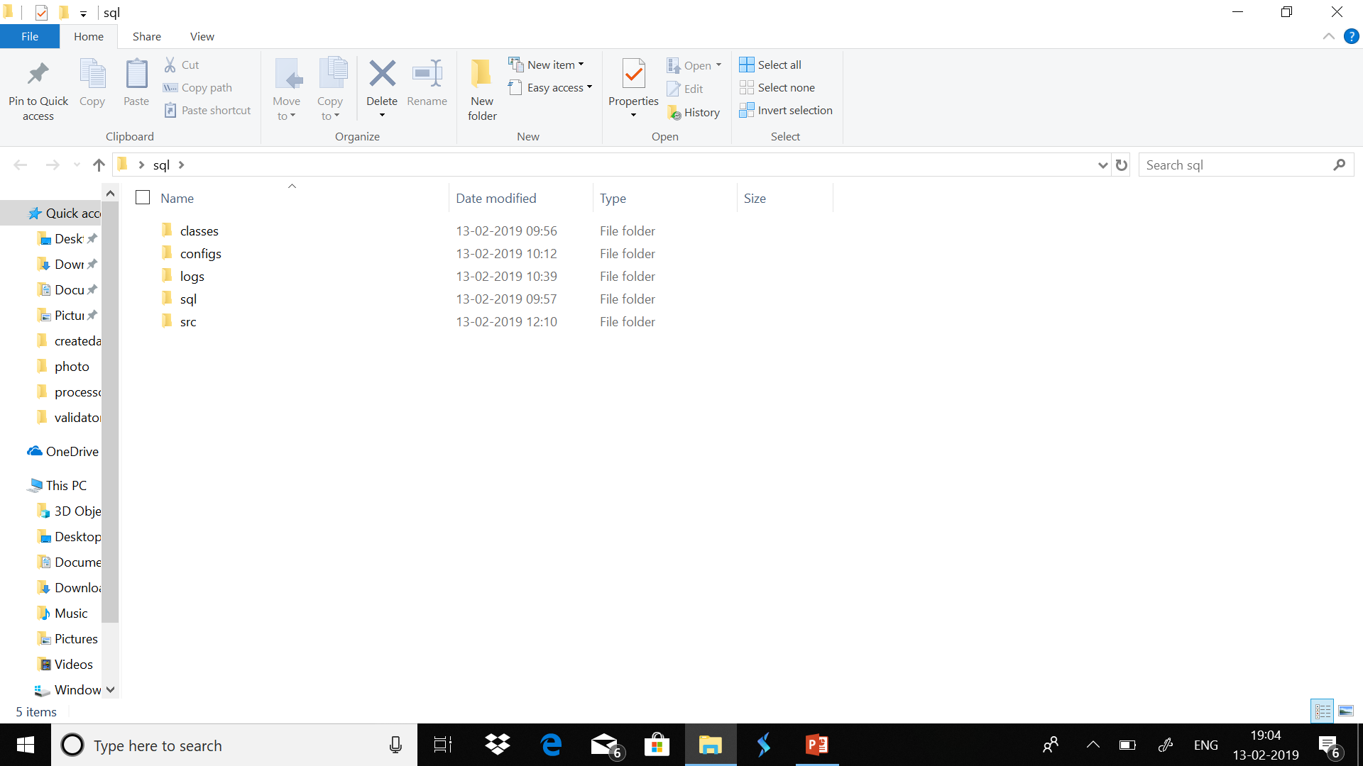
Folder structure:
Scr-com-ncu-excpetion,processor,main-
Configs-properties folder

Slide 4
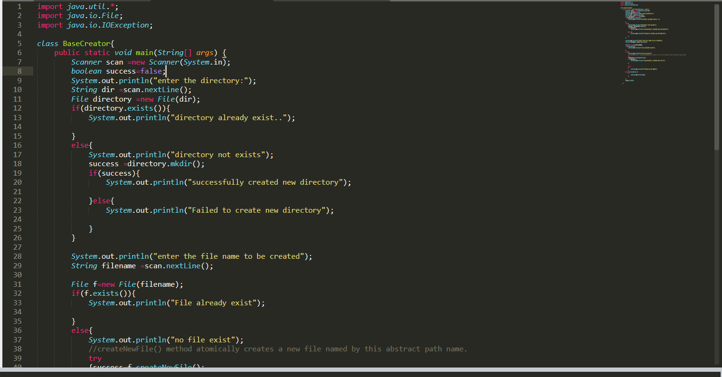
Create the database

Slide 5
Function used:
Mkdir()----it is of Boolean type.
Method
In java.io.file package.
Indicate whether directory is properly made or not.

Slide 6
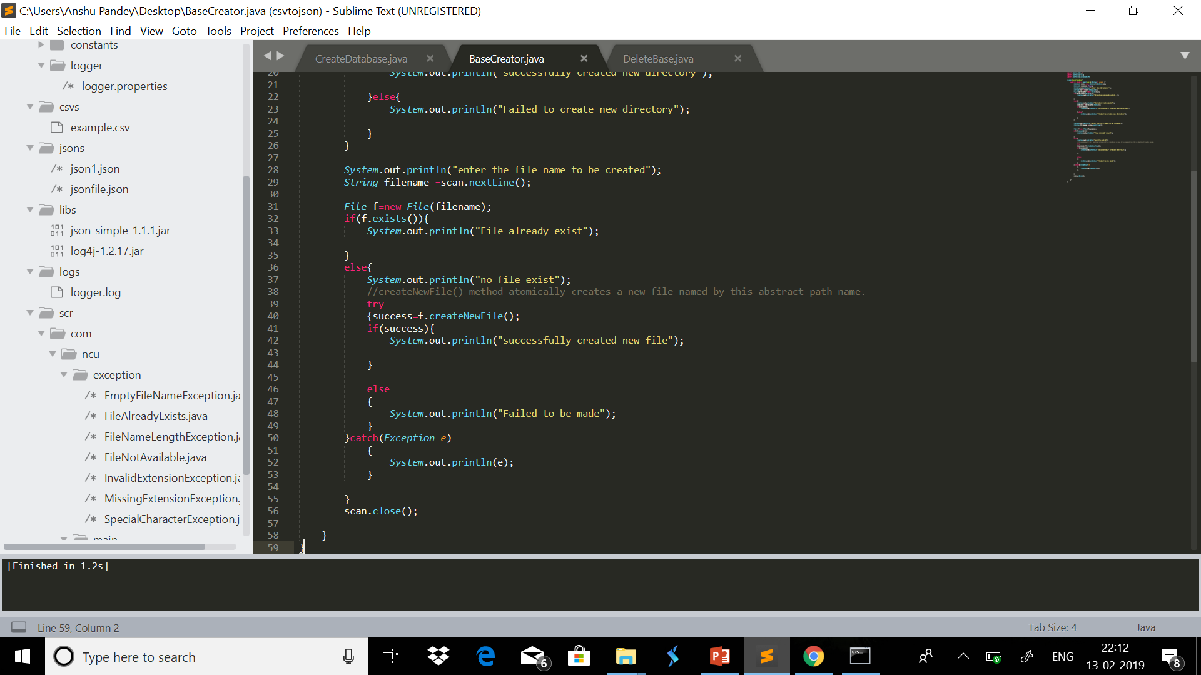

Slide 7
BASE CREATOR : SYNTAX:
public static void main(String[] args) {
Scanner scan =new Scanner(System.in);
boolean success=false;// a variable used type boolean
System.out.println("enter the directory:");
String dir =scan.nextLine();
File directory =new File(dir);

Slide 8
if(directory.exists()){
System.out.println("directory already exist..");
}
else{
System.out.println("directory not exists");
success =directory.mkdir();//used to create the directory and its type is boolean
if(success){
System.out.println("successfully created new directory");
}else{
System.out.println("Failed to create new directory");
}
}

Slide 9
System.out.println("enter the file name to be created");
String filename =scan.nextLine();
File f=new File(filename);
if(f.exists()){
System.out.println("File already exist");
}
else{
System.out.println("no file exist");
//createNewFile() method atomically creates a new file named by this abstract path name.
try
{success=f.createNewFile();
if(success){
System.out.println("successfully created new file");
}
else
{
System.out.println("Failed to be made");
}
}

Slide 10
catch(Exception e)
{
System.out.println(e);
}
}
scan.close();
}
}

Slide 11
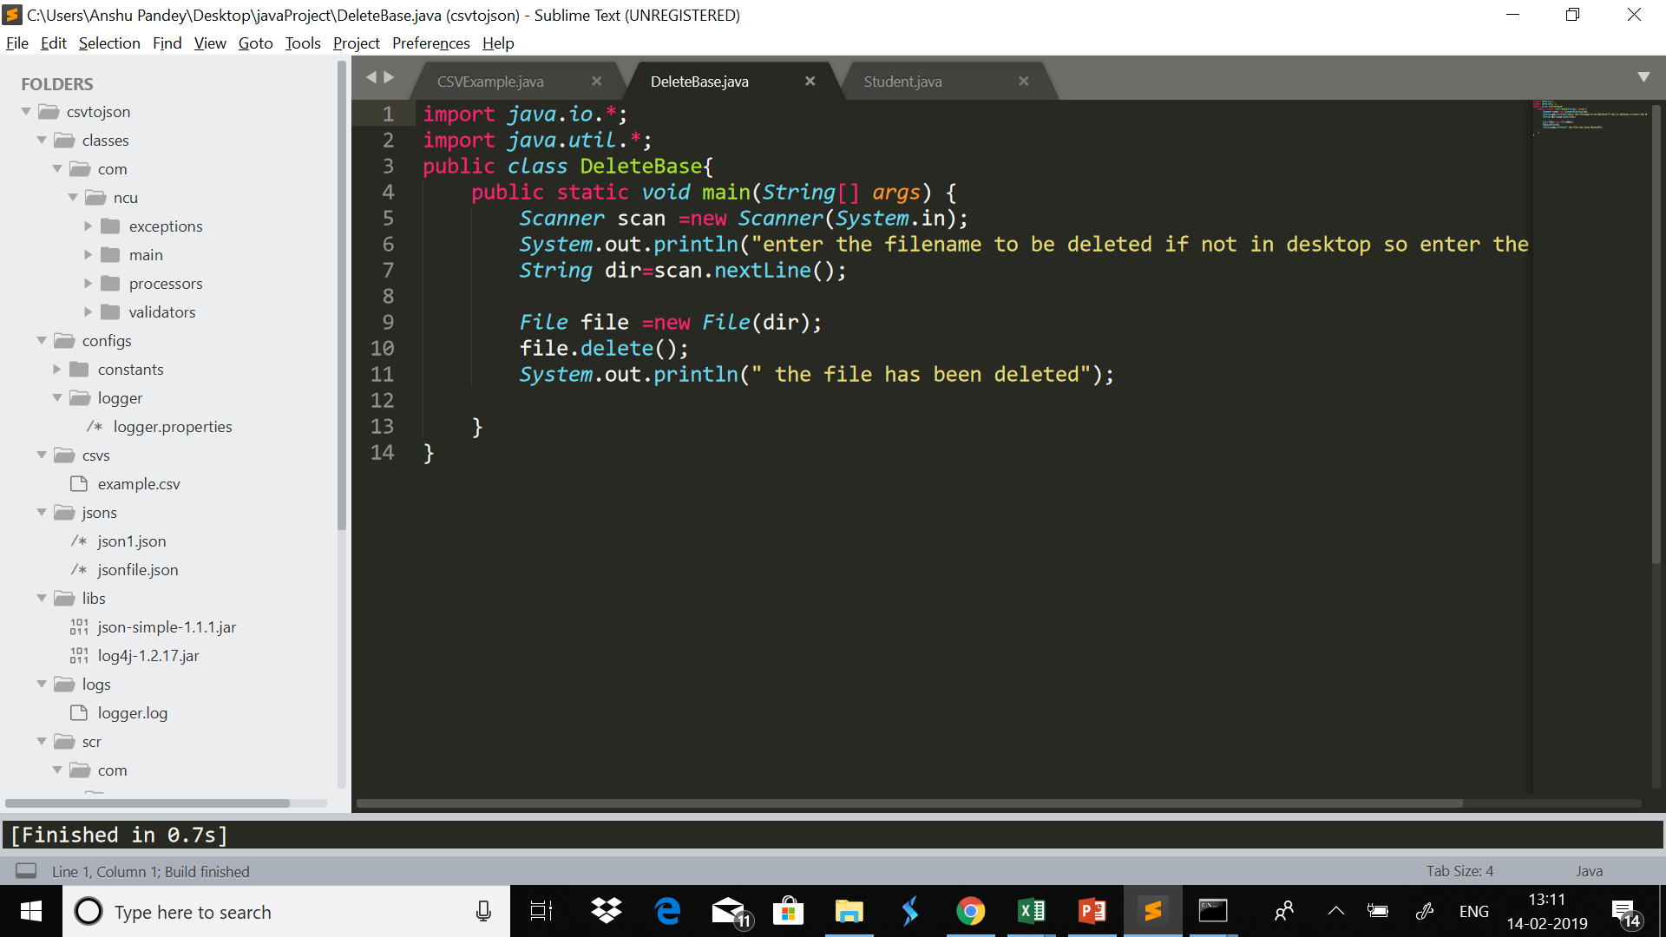
Delete the database

Slide 12
DELETING THE DATABASE: SYNTAX:
public static void main(String[] args) {
Scanner scan =new Scanner(System.in);
System.out.println("enter the filename to be deleted if not in desktop so enter the directory");
String dir=scan.nextLine();
File file =new File(dir);
file.delete();
System.out.println(" the file has been deleted");
}

Slide 13
Create Table:
1)table details from user
2)columns will be provided
3)file name should be as tablename
String id;
String name;
String clname;
char section;
============================================
A) columns to be created by name of
B)the program should ask the number of ID info to be added
C) and the user will enter the info of the person

Slide 14
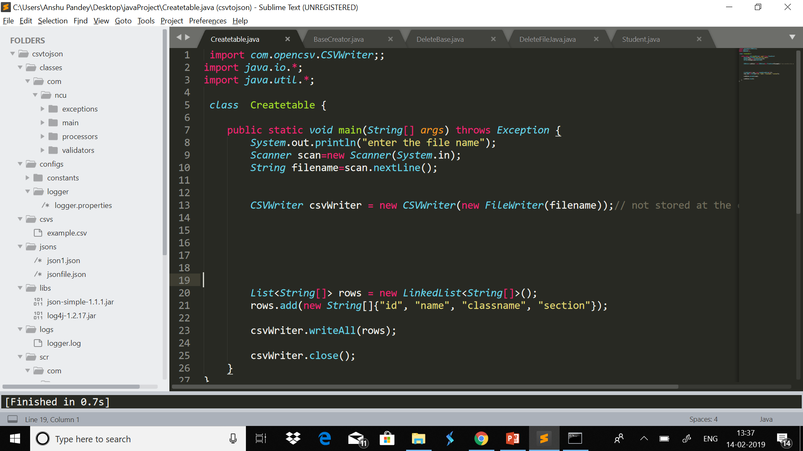

Slide 15
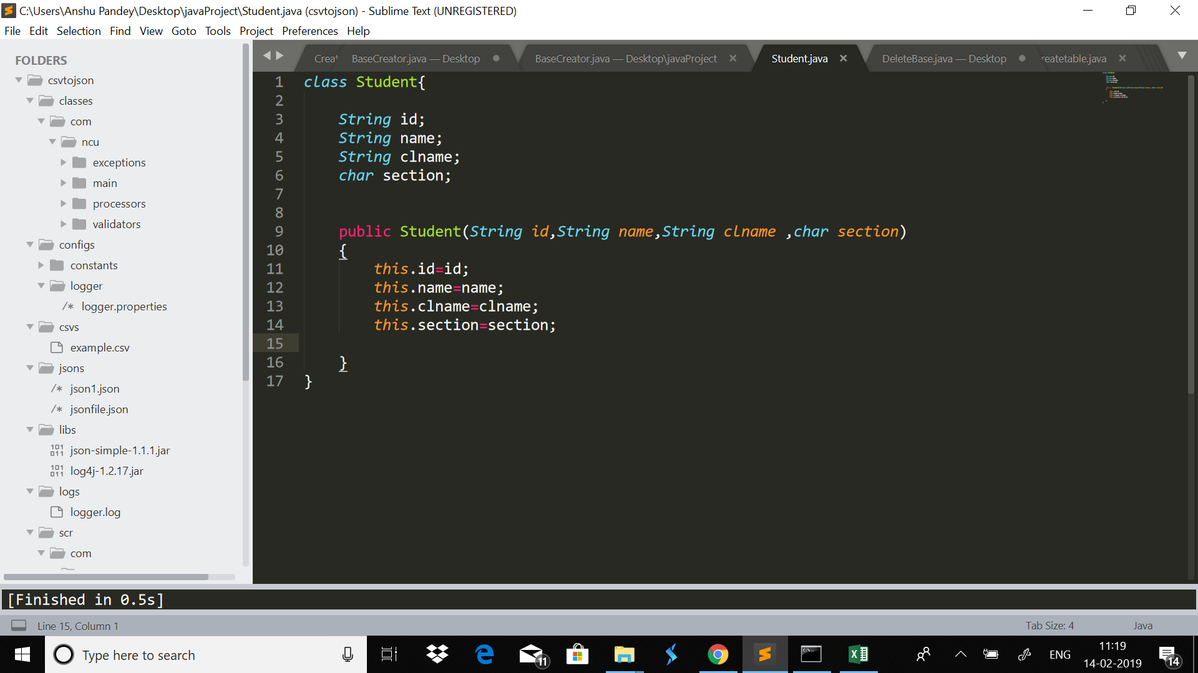
If have created a class Student and created a constutor:

Slide 16
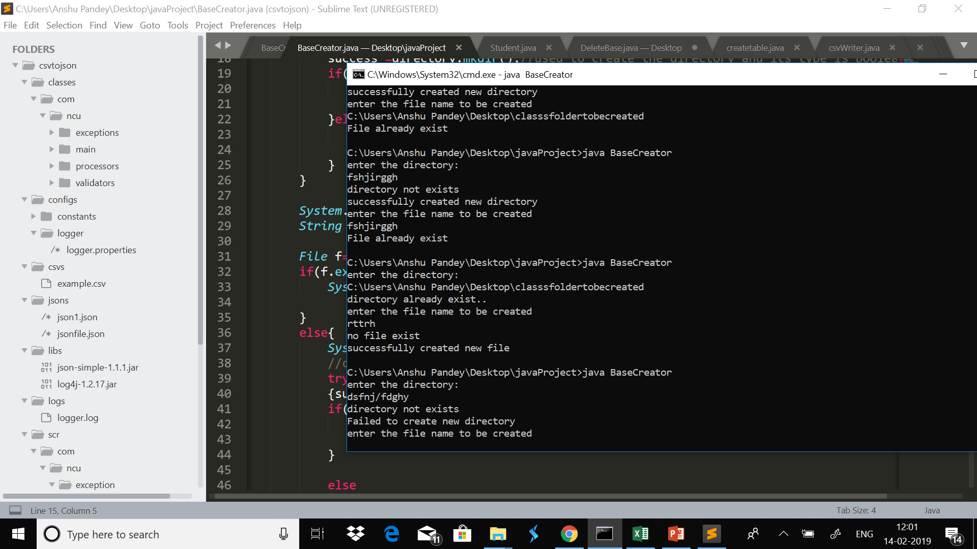

Slide 17
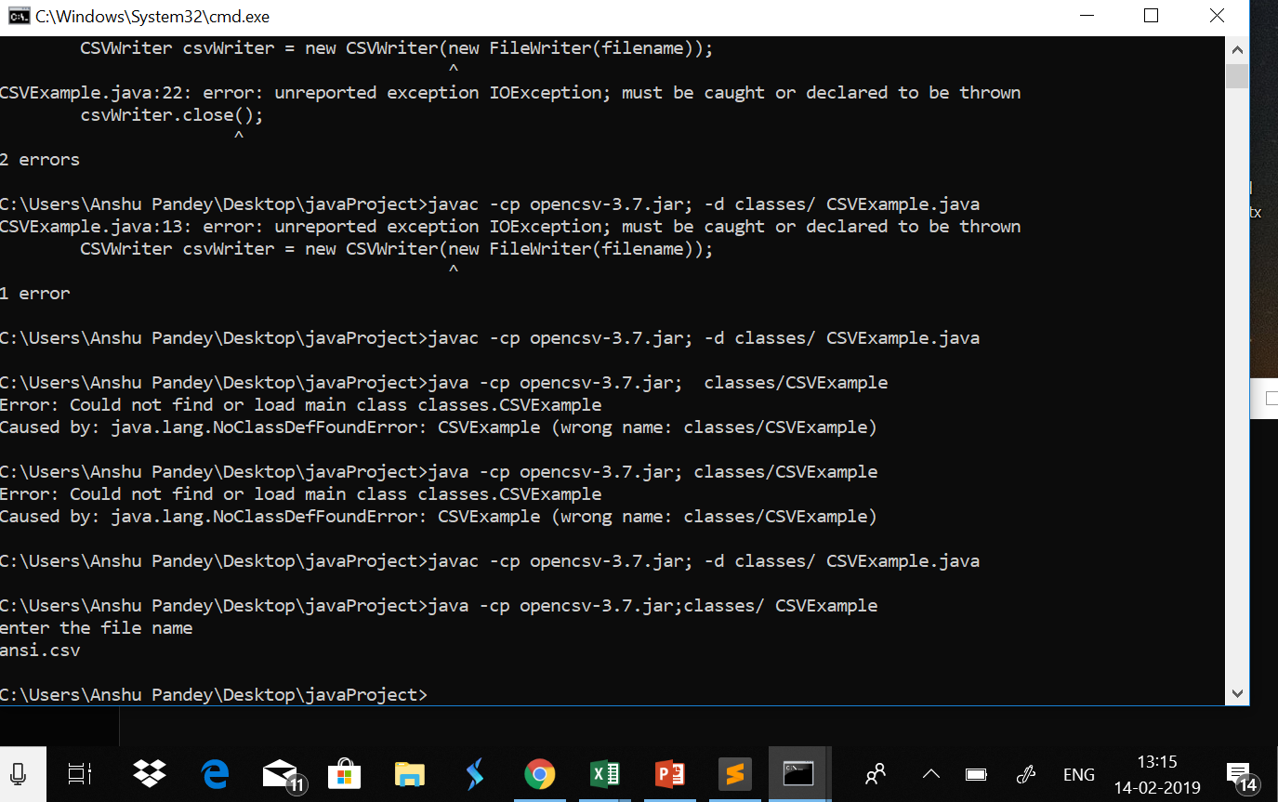
Create table

Slide 18
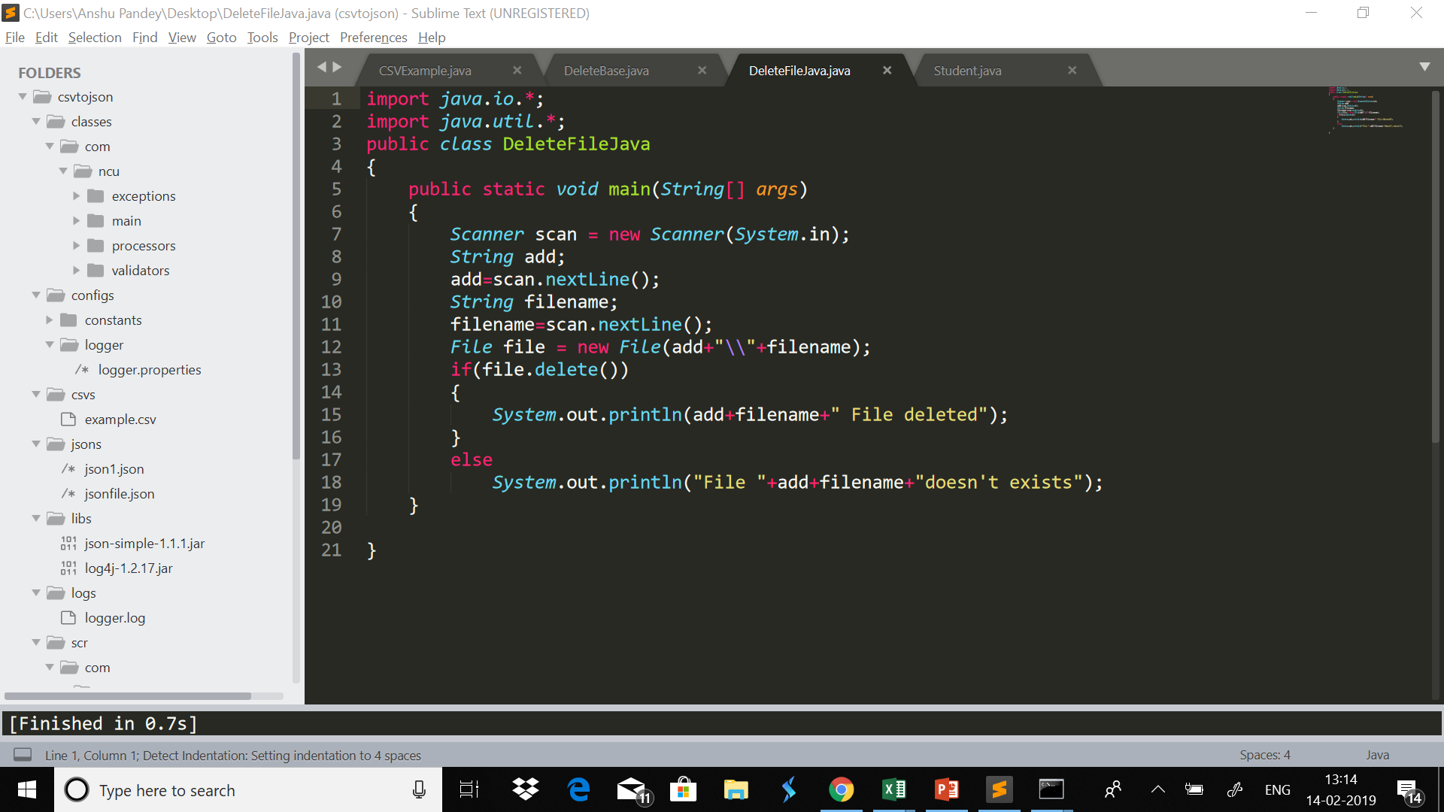
Delete Table:

